Slide 1

Predicting Customer Conversion on Bank Telemarketing Dataset using
Machine Learning
Guided By:
Mrs. Trupti Joshi
Mr. Tushar Kute
Submitted By:
Chetan Amrao (220943025004)
Mandar Patil (220943025017)
Kaustubh Patil (220943025025)
Prince Ganer (220943025028)
12/03/2023
1

Slide 2
Outline
Introduction
Problem Statement
System Architecture
Data Collection
Data Pre-Processing
Methodology
Machine Learning Algorithms
Model Performance Summary
Conclusion
Future Scope
2
12/03/2023
2

Slide 3
Introduction
Telemarketing is a technique used by marketing professionals to attract new customers and keep hold of old customers. It is used in sectors like banking, financial services and insurance (BFSI), information technology and telecommunications, and consulting to locate potential consumers through phone calls where they are asked to purchase goods or services.
According to Pecan AI's 2022 market research, 84% of marketing leaders use predictive analysis and 40% of marketing professionals a lack of knowledge and training regarding content marketing as another struggle and almost 42% of financial marketers say that hiring top talent is a problem they face in their organization.
We propose two solutions based on telemarketing bank dataset. A model for customer segmentation based on prediction for the part of the month deposit was successfully made and a web tool for marketers to decide which customers to prioritize.
12/03/2023
3
Notes:
Hive and Hive QL statements have been used for querying the data.
For future scope, various different Machine Learning algo0rithm will be implemented on different flight delay datasets.

Slide 4
Problem Statement
Predict whether customer subscribes to
term deposit or not ?
Customer willing to subscribe in which interval ?
Effects of festival days on deposit subscription ?
Customer conversion rate
12/03/2023
4

Slide 5





System Architecture
Raw Kaggle Dataset
ML Classifier
Data preparation
Pre-processing
on notebook
Predictions
Fig.: System Architecture for Predicting Customer Conversion on Bank Telemarketing Dataset using Machine Learning
12/03/2023
5

Slide 6
Data Collection
Bank Full
Bank Additional
Bank Data
1. Fetch raw datasets using API of Kaggle in PySpark dataframe.
45211 rows
41188 rows
86299 rows
2. Applied some necessary operations to concatenate two dataframes.
3. Year mapping in both of the dataframes.
4. Social Metric Index mapping applied on Bank Full dataset
5. Concatenated two dataframes for further operations.
12/03/2023
6

Slide 7
Data Pre-Processing
Merge datasets
Rebuild missing data
Data Encoding
Outliers Removal
Data Balancing& Scaling
Data
Pre- Processing
Data import
12/03/2023
7

Slide 8
Data Preparation
1. Check and remove nulls
2. Label encoding
3. One hot encoding
4. Cleaning outliers
5. Data balancing
6. Data Scaling
12/03/2023
8

Slide 9
Machine Learning Algorithms
Logistic Regression :
Logistic Regression finds the best-fit line (also called the decision boundary) that separates the two classes of the dependent variable.
Support Vector Classifier:
A support vector classifier (SVC) is a machine learning algorithm that separates data into different classes using a hyperplane with the maximum margin between the two classes.
Decision Trees:
Decision trees use entropy, a measure of randomness or impurity in a dataset, to recursively partition data into subsets that have similar class labels and ultimately create a tree-like model that can be used for classification or regression tasks.
Random Forest:
Random forest in machine learning is an ensemble learning method that builds multiple decision trees and aggregates their predictions to improve accuracy and reduce overfitting.
12/03/2023
9

Slide 10
Model Performance Summary
Support Vector Classifier
Accuracy Score : 85%
Logistic Regression
Accuracy Score : 86%
Decision Tree Classifier
Accuracy Score : 87%
Random Forest Classifier
Accuracy Score : 89%
This is the best performer model!
12/03/2023
10

Slide 11
Data Visualization & Representation
Tableau Dashboard
12/03/2023
11

Slide 12
Key Insights found from data analysis
1. Age group of around 25 to 50 years should be the primary focus of
future telemarketing campaigns.
2. Married people have more chances of buying term deposit subscription
followed by single people and then divorced people.
3. People with age between 25 and 50 years can be considered selling loan
related products like housing and personal loan in future campaigns.
4. Marketing strategies can be developed with help of the analyzed call duration.

Slide 13
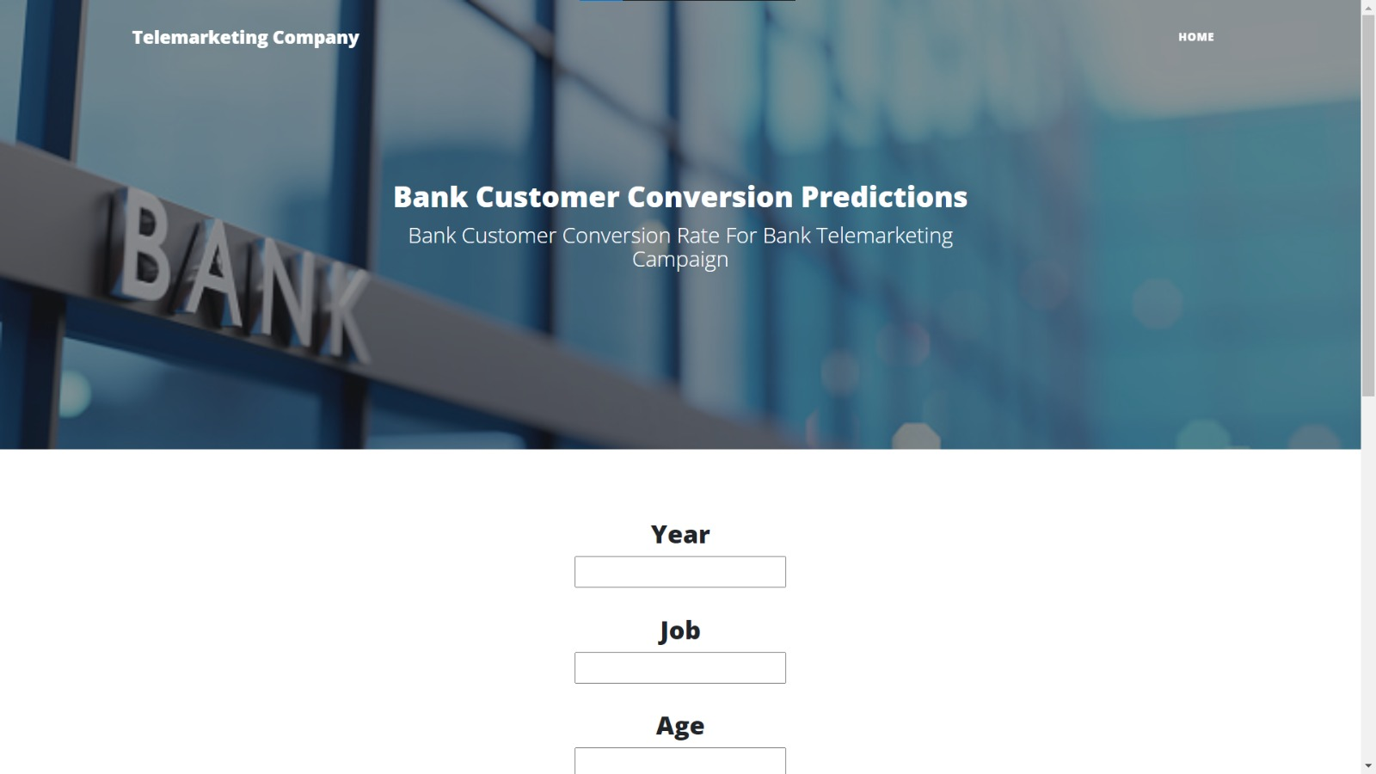
Conclusion and Future Scope
Train chat bot for customer segmentation and product discovery through bank website
Personalization of customer experience through web based portal for bank product
exploration
12/03/2023
13

Slide 14
Thank You

